Slide 1


Khaja Mannan
08/02/2024

Slide 2

Outline
Executive Summary
Introduction
Methodology
Results
Conclusion
Appendix

Slide 3
Executive Summary
Summary of methodologies
Data Collection through API
Data Collection with Web Scraping
Data Wrangling
Exploratory Data Analysis with SQL
Exploratory Data Analysis with Data Visualization
Interactive Visual Analytics with Folium
Machine Learning Prediction
Summary of all results
Exploratory Data Analysis result
Interactive analytics in screenshots
Predictive Analytics result

Slide 4
Introduction
Project background and context
Space X advertises Falcon 9 rocket launches at $62 million, significantly lower than competitors charging up to $165 million. A key factor in cost savings is Space X's ability to reuse the first stage. To compete in bidding against Space X, the project aims to develop a machine learning pipeline predicting the success of the first stage landing, enabling more accurate cost calculations for rocket launches.
Problems you want to find answers
What factors determine if the rocket will land successfully?
The interaction amongst various features that determine the success rate of a successful landing.
What operating conditions needs to be in place to ensure a successful landing program

Slide 5

Section 1

Slide 6
Methodology
Executive Summary
Data collection methodology:
Data was collected using SpaceX API and web scraping from Wikipedia.
Perform data wrangling
We used one-hot encoding on the categorical features.
Perform exploratory data analysis (EDA) using visualization and SQL
Perform interactive visual analytics using Folium and Plotly Dash
Perform predictive analysis using classification models
How to build, tune, evaluate classification models

Slide 7
Data Collection
Collecting Data
The data collection process involved utilizing diverse methods. Initially, a GET request was made to the SpaceX API. Subsequently, the response content was decoded into JSON format using the .json() function. The data was further structured into a pandas dataframe through the .json_normalize() function. Following this, data cleaning procedures were implemented, addressing missing values by filling them where necessary.
Additionally, we conducted web scraping on Wikipedia to retrieve Falcon 9 launch records. Using BeautifulSoup, we extracted the launch records presented in HTML tables. The parsed tables were then converted into pandas dataframes, facilitating future analysis of the acquired information.

Slide 8
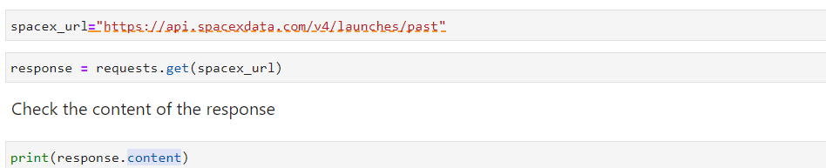
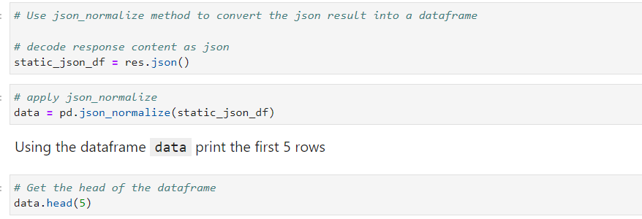
Data Collection – SpaceX API
Data collection with SpaceX REST calls using key phrases and flowcharts
https://github.com/KhajaMannan/IBM-Data-Science-Capstone/blob/main/Data%20Collection%20API.ipynb

Slide 9
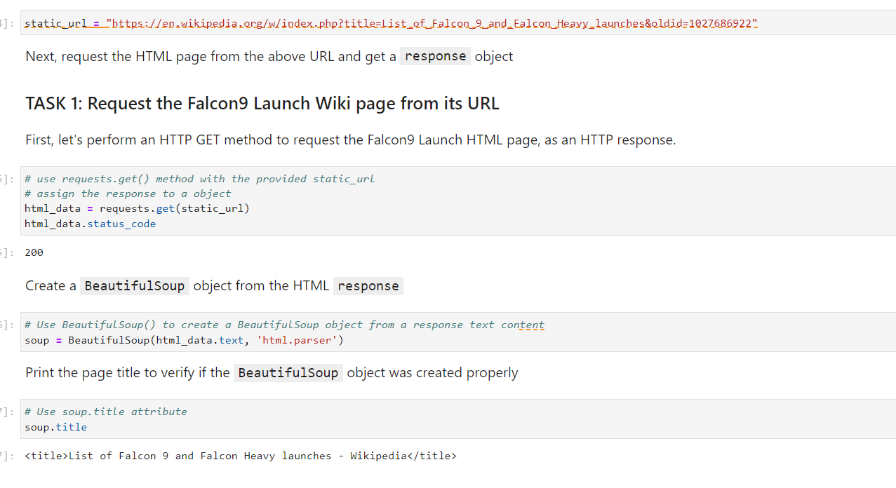
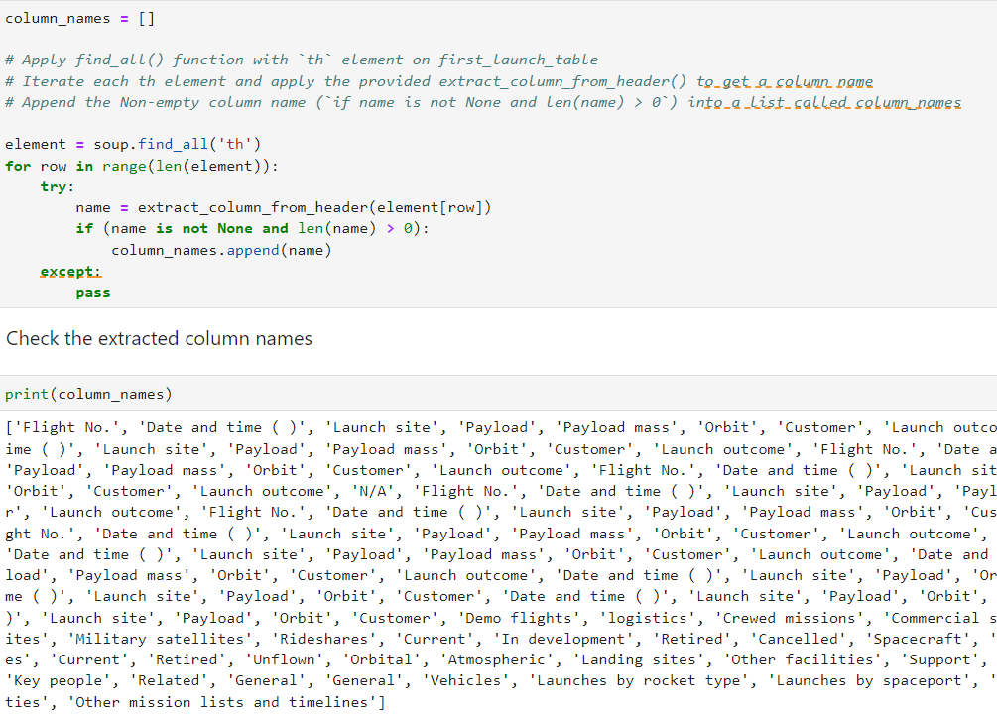
Data Collection - Scraping
Using BeautifulSoup, we used web scraping to gather Falcon 9 launch records.
The table was parsed, and a pandas dataframe was created.
https://github.com/KhajaMannan/IBM-Data-Science-Capstone/blob/main/Data%20Collection%20with%20Web%20Scraping.ipynb

Slide 10
Data Wrangling
We identified the training labels by doing an exploratory data analysis. We determined the quantity of launches at every location as well as the quantity and frequency of each orbit.
From the outcome column, we generated the landing outcome label and saved the data to a CSV file.
The link to the notebook is:
https://github.com/KhajaMannan/IBM-Data-Science-Capstone/blob/main/Data%20Wrangling.ipynb

Slide 11


EDA with Data Visualization
The relationship between the flight number and the launch site, the payload and the launch site, the success rate of each orbit type, the flight number and the orbit type, and the annual trend of launch success were all visualised as we investigated the data.
https://github.com/KhajaMannan/IBM-Data-Science-Capstone/blob/main/EDA%20with%20Data%20Visualization.ipynb

Slide 12
EDA with SQL
The SpaceX dataset was seamlessly loaded into a PostgreSQL database within the Jupyter Notebook environment. Employing SQL for Exploratory Data Analysis (EDA), we crafted queries to extract valuable insights from the dataset.
Queries were designed to reveal:
Unique launch site names in the space mission.
Total payload mass carried by NASA-launched boosters in CRS missions.
Average payload mass carried by booster version F9 v1.1.
The overall count of successful and failed mission outcomes.
Further, we investigated failed landing outcomes on drone ships, extracting details like booster versions and launch site names through precise SQL queries.
The link to the notebook is: https://github.com/KhajaMannan/IBM-Data-Science-Capstone/blob/main/EDA%20with%20SQL.ipynb
. Add the GitHub URL of your completed EDA with SQL notebook, as an external reference and peer-review purpose

Slide 13
Build an Interactive Map with Folium
Launch sites were marked on a Folium map using map objects like markers, circles, and lines to visually indicate the success or failure of launches at each site.
Class labels (0 for failure, 1 for success) were assigned to launch outcomes, facilitating color-coded marker clusters on the map for easy identification of success rates at different sites.
Distances between launch sites and their surroundings were calculated, addressing questions about proximity to railways, highways, coastlines, and whether certain distances were maintained from cities.
GitHub URL- https://github.com/KhajaMannan/IBM-Data-Science-Capstone/blob/main/Interactive%20Visual%20Analytics%20with%20Folium.ipynb

Slide 14
Build a Dashboard with Plotly Dash
Utilizing Plotly Dash, we successfully developed an interactive dashboard.
The dashboard includes informative pie charts depicting the total launches for specific launch sites.
Scatter graphs were incorporated into the dashboard, showcasing the relationship between launch outcomes and payload mass (measured in kilograms) across different booster versions.
Github URL-https://github.com/KhajaMannan/IBM-Data-Science-Capstone/blob/main/spacex_dash_app.py

Slide 15
Predictive Analysis (Classification)
Data loading was accomplished using both NumPy and Pandas, facilitating efficient handling of the dataset.
The data underwent transformation processes, ensuring its suitability for machine learning tasks.
A strategic split was implemented, segregating the data into training and testing sets to assess model performance.
Multiple machine learning models were constructed, and various hyperparameters were fine-tuned using GridSearchCV.
Model evaluation was conducted using accuracy as the primary metric, and continuous improvement was achieved through feature engineering and algorithm tuning.
The classification model with the highest performance was identified as the best-performing model.
GitHub Url -https://github.com/KhajaMannan/IBM-Data-Science-Capstone/blob/main/Machine%20Learning%20Prediction.ipynb

Slide 16
Results
Results from Exploratory Data Analysis (EDA),
Screenshots showcasing an Interactive Analytics Demo,
Findings from Predictive Analysis.

Slide 17

Section 2

Slide 18

Flight Number vs. Launch Site
The plot indicates that as the flight count at a launch site increases, there is a corresponding rise in the success rate at that specific launch site.

Slide 19
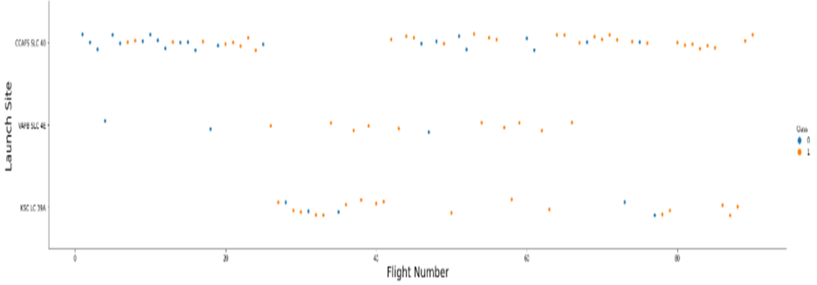
Payload vs. Launch Site
The success rate for rockets at launch site CCAFS SLC 40 tends to increase with higher payload masses, as depicted in the graph above.

Slide 20

Success Rate vs. Orbit Type
The graph highlights that ES-L1, GEO, HEO, SSO, and VLEO exhibit the highest success rates among the listed categories.

Slide 21
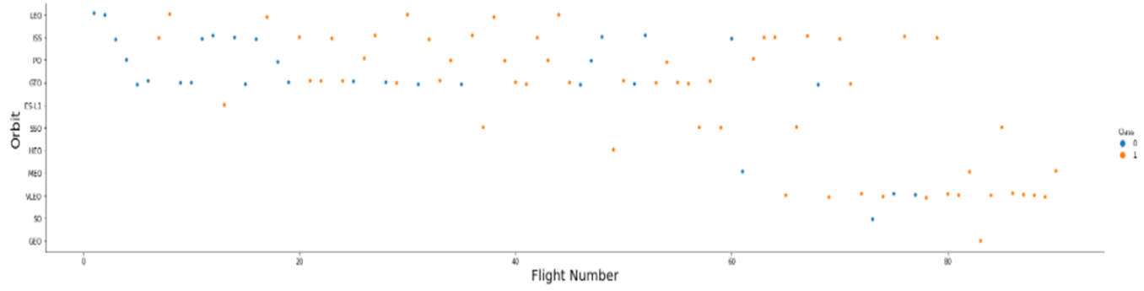
Flight Number vs. Orbit Type
In the depicted graph illustrating Flight Number versus Orbit type, it is apparent that success in the LEO orbit correlates with the number of flights. However, in the GTO orbit, there is no discernible relationship between flight number and orbit success.

Slide 22
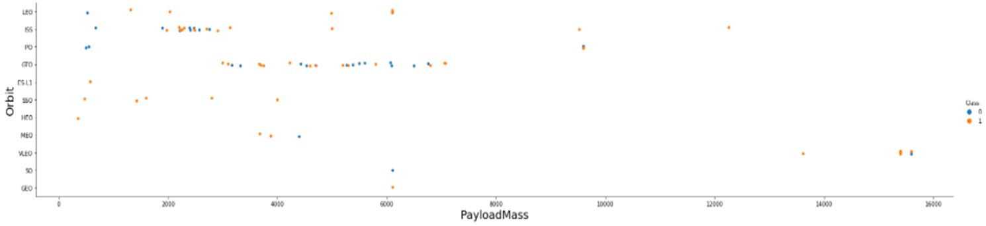
Payload vs. Orbit Type
It is evident from the observation that successful landings are more frequent for PO, LEO, and ISS orbits when dealing with heavy payloads.

Slide 23
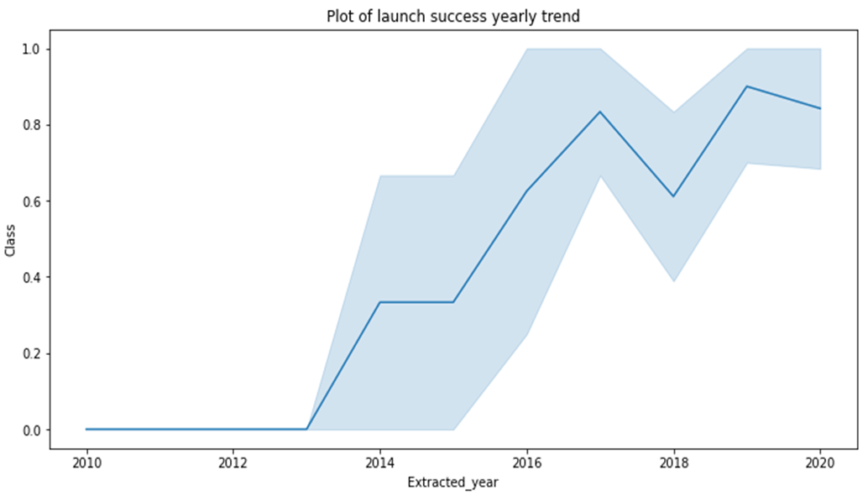
Launch Success Yearly Trend
The plot illustrates a consistent upward trend in the success rate from 2013 to 2020.

Slide 24

All Launch Site Names
The DISTINCT keyword was employed to display only unique launch sites within the SpaceX dataset.

Slide 25

Launch Site Names Begin with 'CCA'
The aforementioned query was utilized to exhibit five records where launch sites commence with 'CCA'.

Slide 26

Total Payload Mass
Using the following query, we computed that the total payload carried by NASA boosters amounts to 45,596.

Slide 27

Average Payload Mass by F9 v1.1
Through the execution of the provided query, we determined that the average payload mass carried by the booster version F9 v1.1 is 2,928.4.

Slide 28

First Successful Ground Landing Date
We observed that the dates of the first successful landing outcome on ground pad was 22nd December 2015

Slide 29
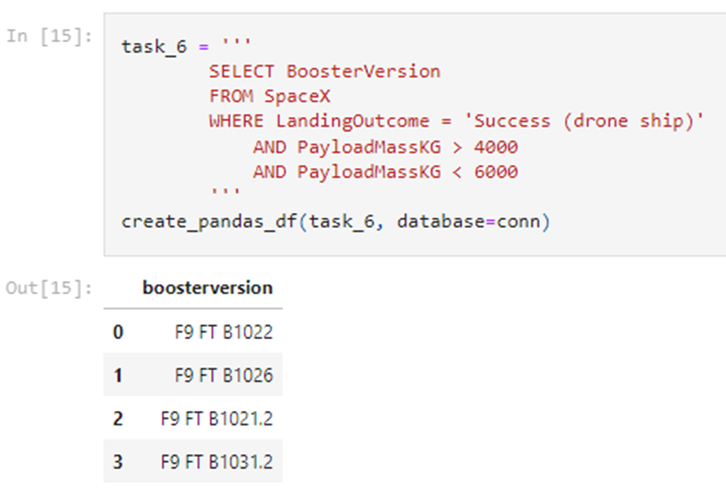
Successful Drone Ship Landing with Payload between 4000 and 6000
We used the WHERE clause to filter for boosters which have successfully landed on drone ship and applied the AND condition to determine successful landing with payload mass greater than 4000 but less than 6000

Slide 30

Total Number of Successful and Failure Mission Outcomes
We used wildcard like ‘%’ to filter for WHERE MissionOutcome was a success or a failure.

Slide 31

Boosters Carried Maximum Payload
We determined the booster that have carried the maximum payload using a subquery in the WHERE clause and the MAX() function.

Slide 32

2015 Launch Records
We used a combinations of the WHERE clause, LIKE, AND, and BETWEEN conditions to filter for failed landing outcomes in drone ship, their booster versions, and launch site names for year 2015

Slide 33

Rank Landing Outcomes Between 2010-06-04 and 2017-03-20
We selected Landing outcomes and the COUNT of landing outcomes from the data and used the WHERE clause to filter for landing outcomes BETWEEN 2010-06-04 to 2010-03-20.
We applied the GROUP BY clause to group the landing outcomes and the ORDER BY clause to order the grouped landing outcome in descending order.

Slide 34

Section 3

Slide 35

All launch sites global map markers

Slide 36

Markers showing launch sites with color labels

Slide 37

Launch Site distance to landmarks

Slide 38

Section 4

Slide 39

Pie chart showing the success percentage achieved by each launch site

Slide 40

Pie chart showing the Launch site with the highest launch success ratio

Slide 41

Section 5

Slide 42

Classification Accuracy

Slide 43

Confusion Matrix
The confusion matrix for the decision tree classifier shows that the classifier can distinguish between the different classes. The major problem is the false positives .i.e., unsuccessful landing marked as successful landing by the classifier.

Slide 44
Conclusions
We can conclude that:
The larger the flight amount at a launch site, the greater the success rate at a launch site.
Launch success rate started to increase in 2013 till 2020.
Orbits ES-L1, GEO, HEO, SSO, VLEO had the most success rate.
KSC LC-39A had the most successful launches of any sites.
The Decision tree classifier is the best machine learning algorithm for this task.

Slide 45


